Slide 1

Remote CARI (rCARI) Validation Study
Annotated Responses to BHA Questions
RAM-N – rCARI Team | Nov 2023

Slide 2
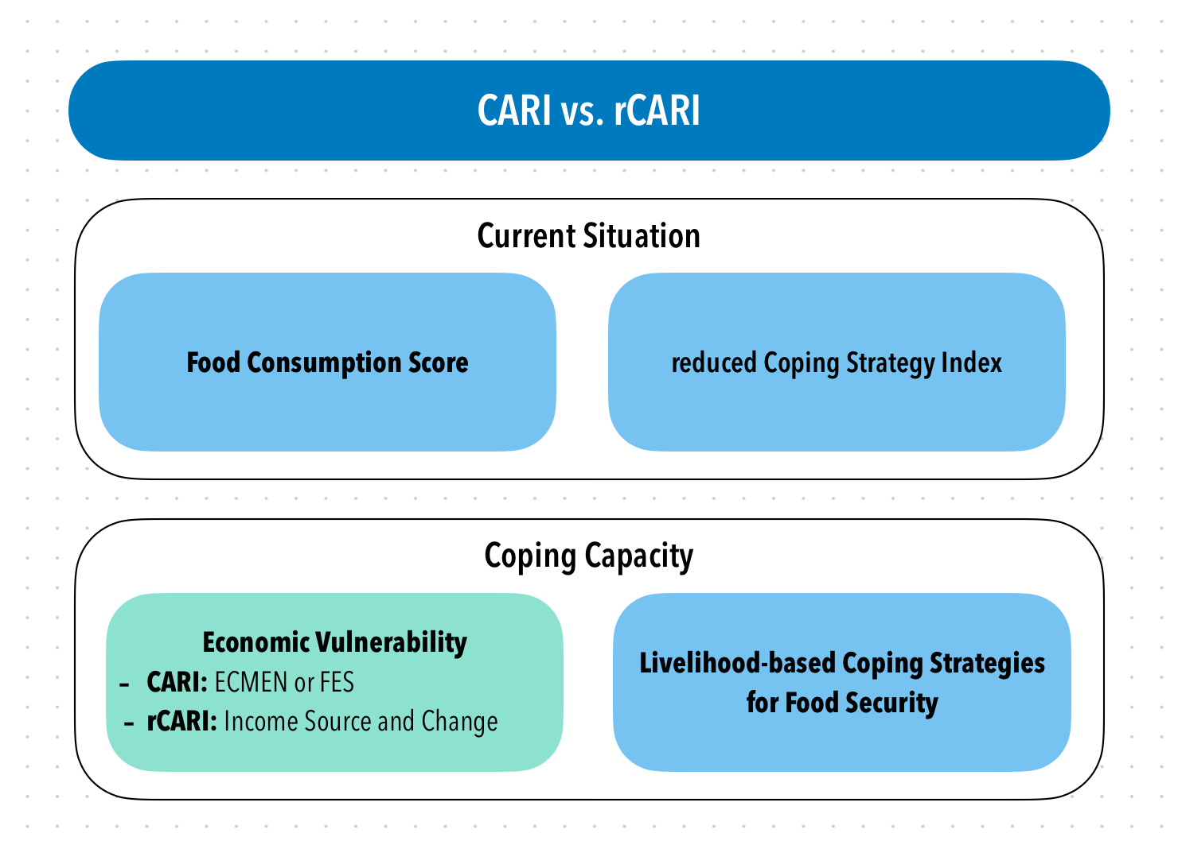
Background
CARI and rCARI (remote CARI) aggregate indicators in a similar way and the only difference is in the Economic Vulnerability
To date, rCARI is not validated
Notes:
Consolidate Approach for Reporting food Insecurity (CARI)
rCARI useful in emergencies where F2F survey is not feasible
rCARI though easily available, results are not globally accepted because methodology is not been empirically validated against other standard methods- CARI
rCARI is based on the following modules
Food consumption score
Consumption-based coping strategy (rCSI)
Livelihood coping strategy (usually a shorter version of the original)
Income sources & income changes

Slide 3
How to call the study Methodoloy…
The rCARI Team (WFP-HQ) has initially called a study a “Randomized Control Trial - RCT” based on the recommendation of the Advisory Board.
The RCT name was not accepted
No Treatment or Control being administered
After a wide consultation, the name has been revised as a “Survey Experiment” with stratified sample

Slide 4
Overall sampling study framework
Study-Country
Simple random sampling to select at least 2 regions /livelihood zones based on the food security situation.
Livelihood Zones/Admin1 Area
Based on the number of regions selected, draw a list of districts from the selected regions and select min. of 4 districts. Equally distributed in the Admin1
Admin2 Districts
In the same manner, list all the smallest administrative units within the Admin2 (e.g., villages) and randomly select 20 ADMIN3 Units as Primary sampling units or clusters (PSUs). PSU inclusion will be based on mobile phone coverage & accessibility.
Admin3 Villages/Communities
The sampling frame will be all households in each PSU. From each PSU, 100 households will be randomly selected. Final sampled households (2000-) will be randomized into two groups, i.e., F2F Group and Remote Group.
Sampled Households
CARI Sample
(F2F)
rCARI Sample
(Remote)
CARI Sample will receive the Face-2-Face modules while rCARI Sample will receive the Remote modules simultaneously.

Slide 5
Methodology & Sample

Slide 6
Overall sampling framework
Study-Country
Simple random sampling to select at least 2 regions /livelihood zones based on the food security situation.
Livelihood Zones/Admin1 Area
Based on the number of regions selected, draw a list of districts from the selected regions and select min. of 4 districts. Equally distributed in the Admin1
Admin2 Districts
In the same manner, list all the smallest administrative units within the Admin2 (e.g., villages) and randomly select 20 ADMIN3 Units as sampling clusters.
Admin3 Villages/Communities
From each PSU, 100 households will be randomly selected. Final sampled households (2000) will be randomized into two groups, i.e., Control Group and Treated Group (1000 households per group). The interviews will be conducted simultaneous to avoid significant changes that may affect the food security between the groups.
Sampled Households
CARI Sample
(F2F)
rCARI Sample
(Remote)
CARI Sample will receive the Face-2-Face modules while rCARI Sample will receive the Remote modules simultaneously.

Slide 7
RCT Design
Listing of HHs
Contact details & baseline demographics collected
1200 Sampled Households
(+ ~20% for non-response)
1200 Sampled Households
(+ ~20% for non-response)
F2F
Half of the sample
(~600HHs)
Remote
Half of the sample
(~600HHs)
1st Random Assignment

Slide 8
RCT Design
Listing of HHs
Contact details & baseline demographics collected
1200 Sampled Households
(+ ~20% for non-response)
F2F
Remote
300 HH Long-modules
300 HH Long-modules
2nd Random Assignment
300 HH Short Modules
300 HH Short Modules

Slide 9
Study Design Caveats
These factors can result in skewed/bias data
Mobile phone penetration
Mobile phone network
Response rate of mobile surveys
Corrected statistically through weighting - Geographical representativeness

Slide 10
Study Design Caveats
Current study is different:
Nationally representative sample
✓ Comparison is on unweighted data not at geographical areas FI
✓ Test remote collection of F2F indicators using same population (comparable statistically)

Slide 11
Sample Completion
 | Country
 | Myanmar | Ecuador | CAR | Total
N | 1,665 (27.2%) | 2,372 (38.8%) | 2,080 (34.0%) | 6,117 (100.0%)
Survey Progress
Not Completed | 572 (34.4%) | 956 (40.3%) | 835 (40.1%) | 2,363 (38.6%)
Completed | 1,093 (65.6%) | 1,416 (59.7%) | 1,245 (59.9%) | 3,754 (61.4%)
Survey Modality
Face-to-Face | 610 (55.8%) | 760 (53.7%) | 969 (77.8%) | 2,339 (62.3%)
Remote | 483 (44.2%) | 656 (46.3%) | 276 (22.2%) | 1,415 (37.7%)
Source: rCARI survey 2023; For CAR, the current analysis is limited to phone owners only.

Slide 12
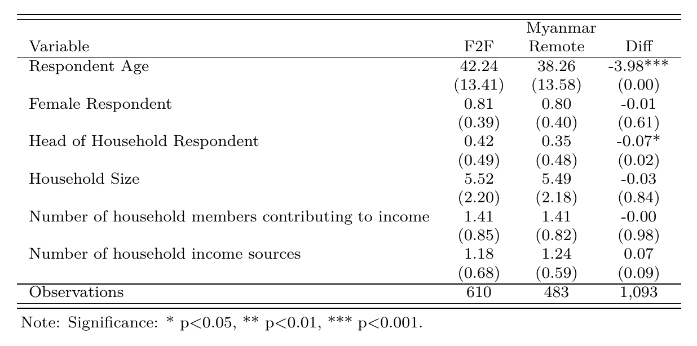
Myanmar Sample Balance

Slide 13
Ecuador - Sampling & Completion
1547 (1489)
HHs
Remote
741 HHs
F2F
748 HHs
1673 (884)
HHs
First Phase Listing (No. HHs after cleaning)
1st Randomization
Second Phase Listing (No. HHs after cleaning)
F2F
425 HHs
Remote
458 HHs
2nd Randomization
Completed Remote
656 HHs
Completed
F2F
760 HHs
Final Completion

Slide 14
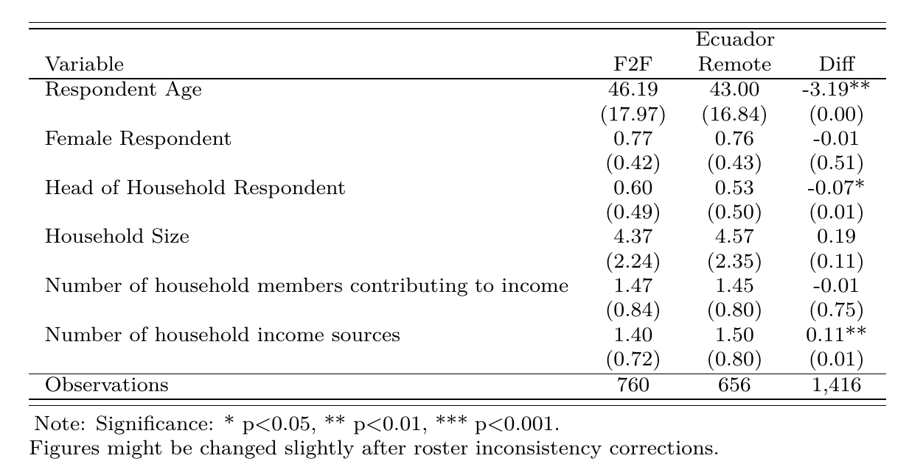
Ecuador Sample Balance

Slide 15
2500 HHs
Yes (25%)
628 HHs
Remote
308 HHs
F2F
320 HHs
No (75%)
1872 HHs
Yes (78%)
1452 HHs
Listed HHs - [Sample frame after cleaning]
Step 1: ID Phone ownership
1st Stage Randomization
Remote
715 HHs
No (22%)
420 HHs
F2F
737 HHs
Network coverage at the HH
2nd Stage Randomization
Yes
300 HHs
No
415 HHs
3rd Stage Randomization-Phone assignment
Completed interviews
157 HHs
119 HHs
294 HHs
675 HHs
Households dropped from Randomization

Slide 16
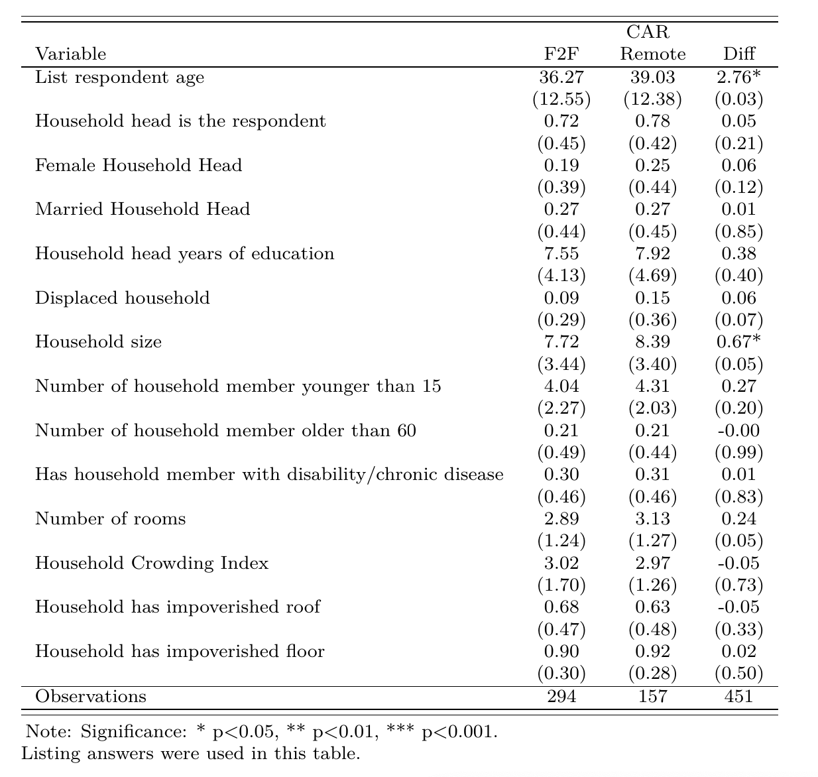
CAR Sample Balance – Phone Owners

Slide 17
Main findings

Slide 18
CARI vs. rCARI

Slide 19
Aggregation methods to be tested
Aggregation Methodology | Aggregation Methodology
Indicator | Standard | Comparison
Indicator | CARI-FES | CARI-Inc (1) | rCARI-Inc (2) | rCARI-FES (3)
FCS | Yes | Yes | Yes | Yes
LCS | Yes | Yes | Yes | Yes
rCSI | Yes | Yes | Yes | Yes
FES | Yes | No | No | Yes
Income Source & Change | No | Yes | Yes | No
Modality | F2F | F2F | Remote | Remote
4 versions of overall indicators used:
CARI-FES: Standard CARI using FES module from F2F surveys
1. CARI-Inc: CARI using Income & income change from F2F surveys
2. rCARI-Inc: Standard rCARI using Income & income change module from Remote surveys
3. rCARI-FES: CARI using FES module from Remote surveys

Slide 20
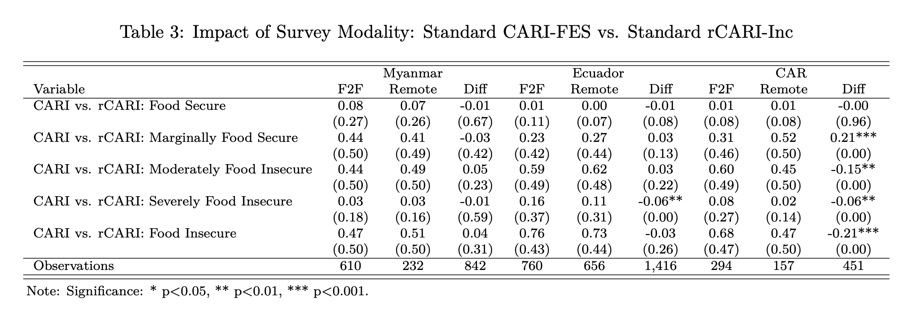

Slide 21
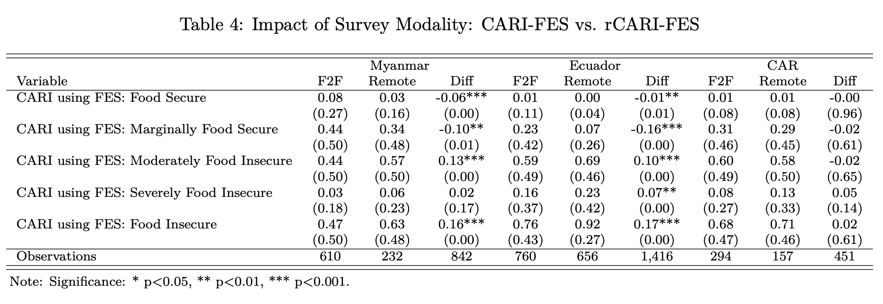

Slide 22
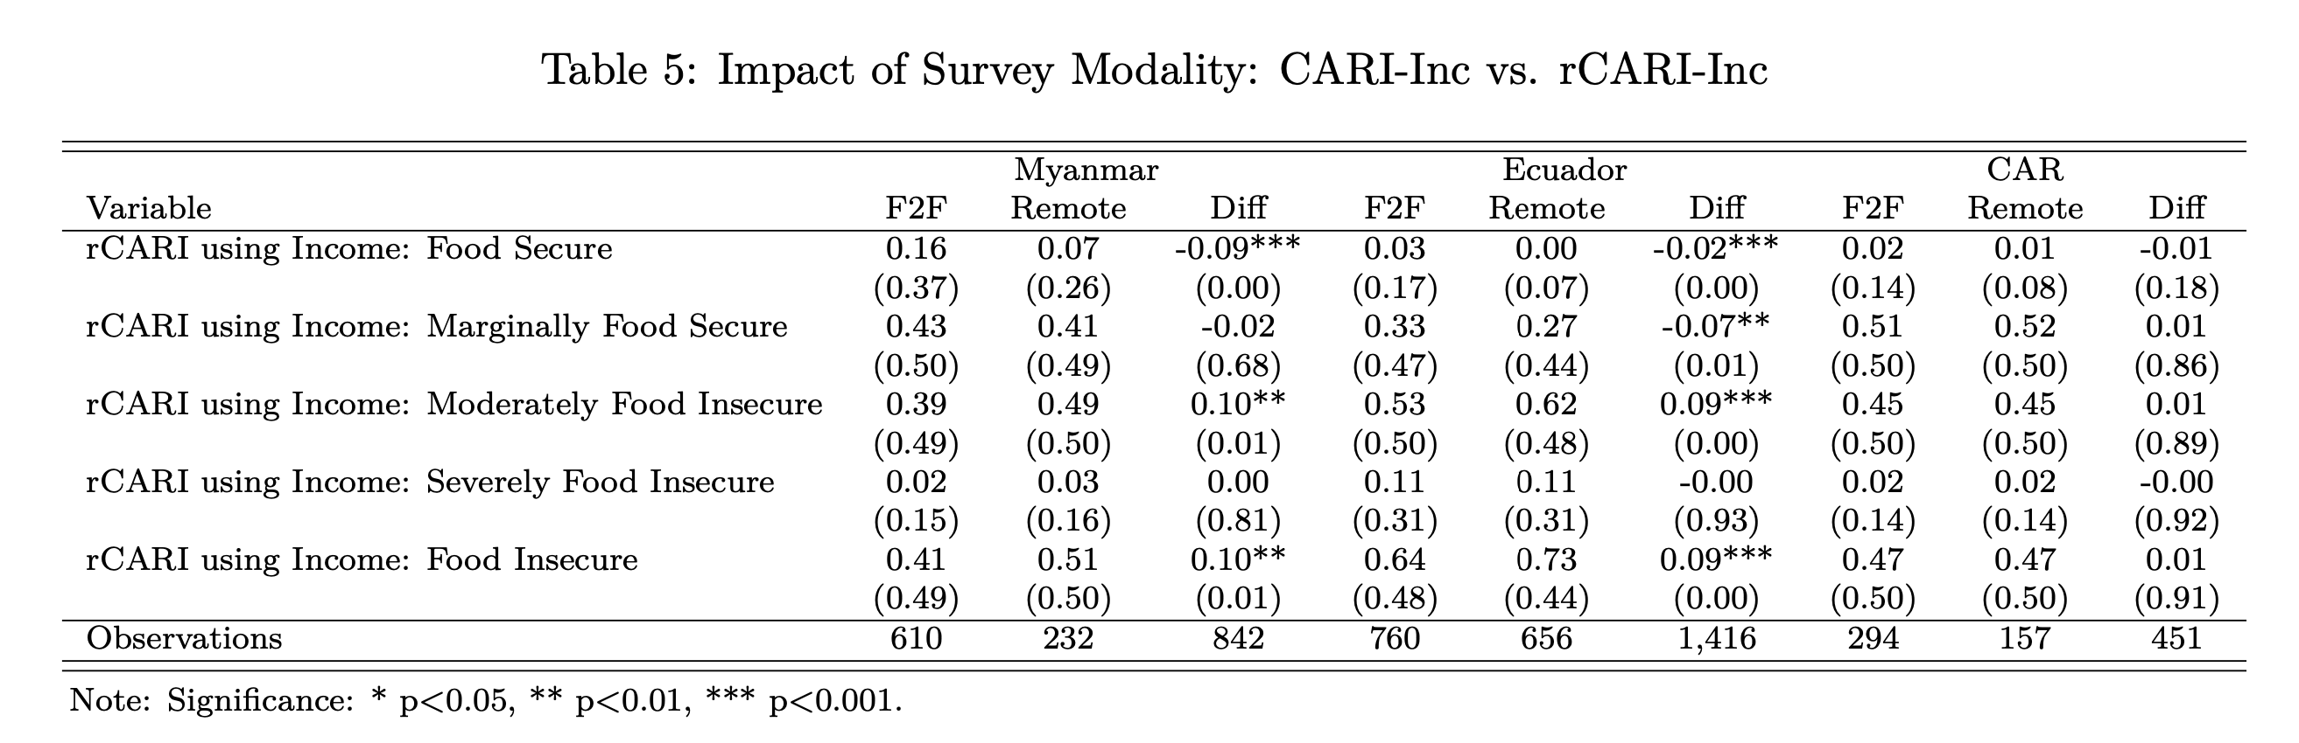

Slide 23
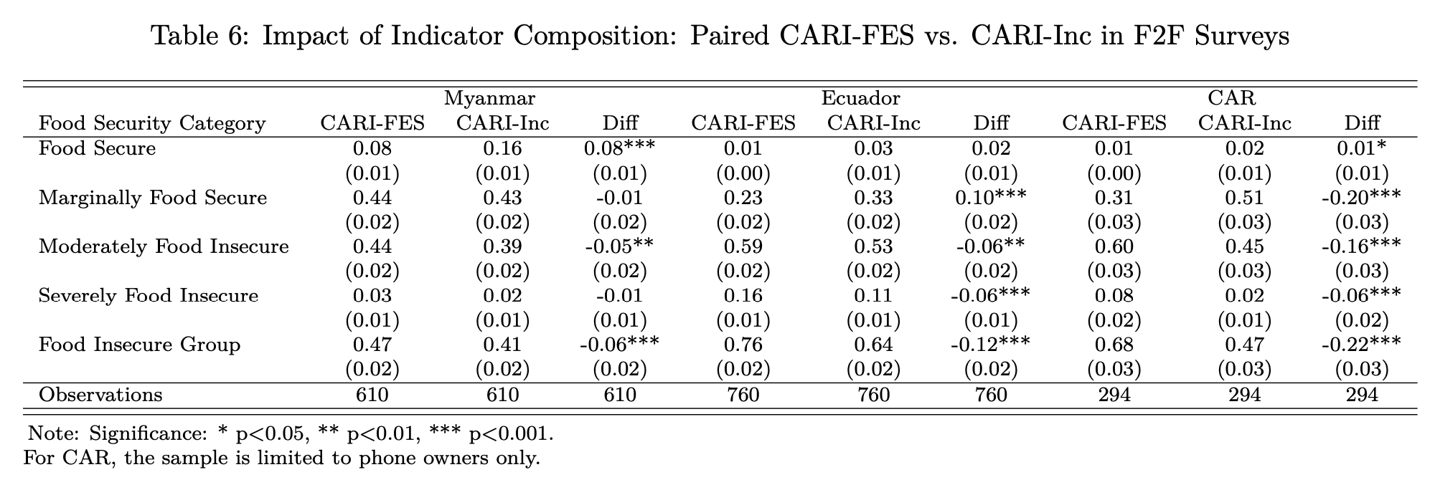
Notes:
When comparing the conventional CARI with the CARI using income sources from the same survey modality and the same households (paired sample). The CARI using income source was conservative in measuring food insecurity by 6 - 22 points in the three countries.

Slide 24
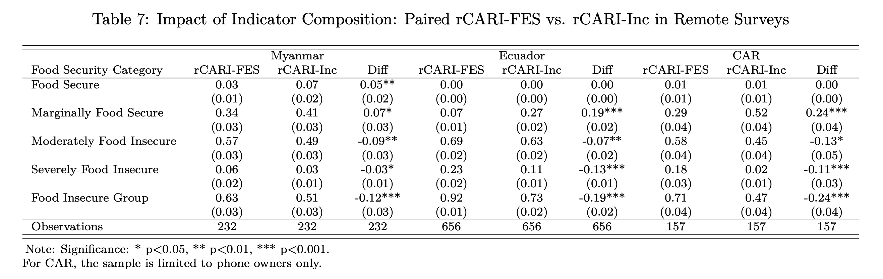

Slide 25
Individual Food Security Indicators

Slide 26
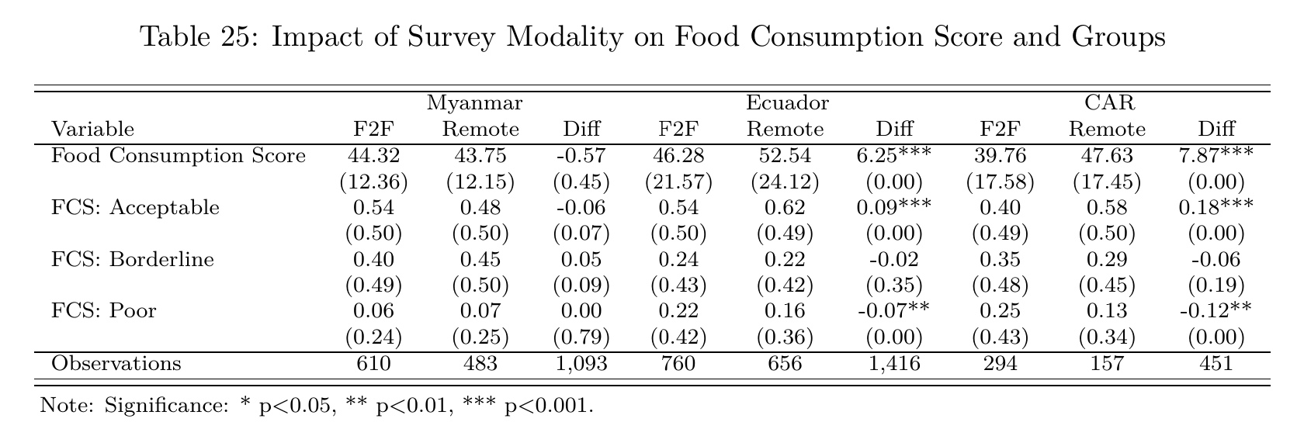
Notes:
Remote interviews reports better consumption meaning under-stating food insecurity across pilot countries

Slide 27
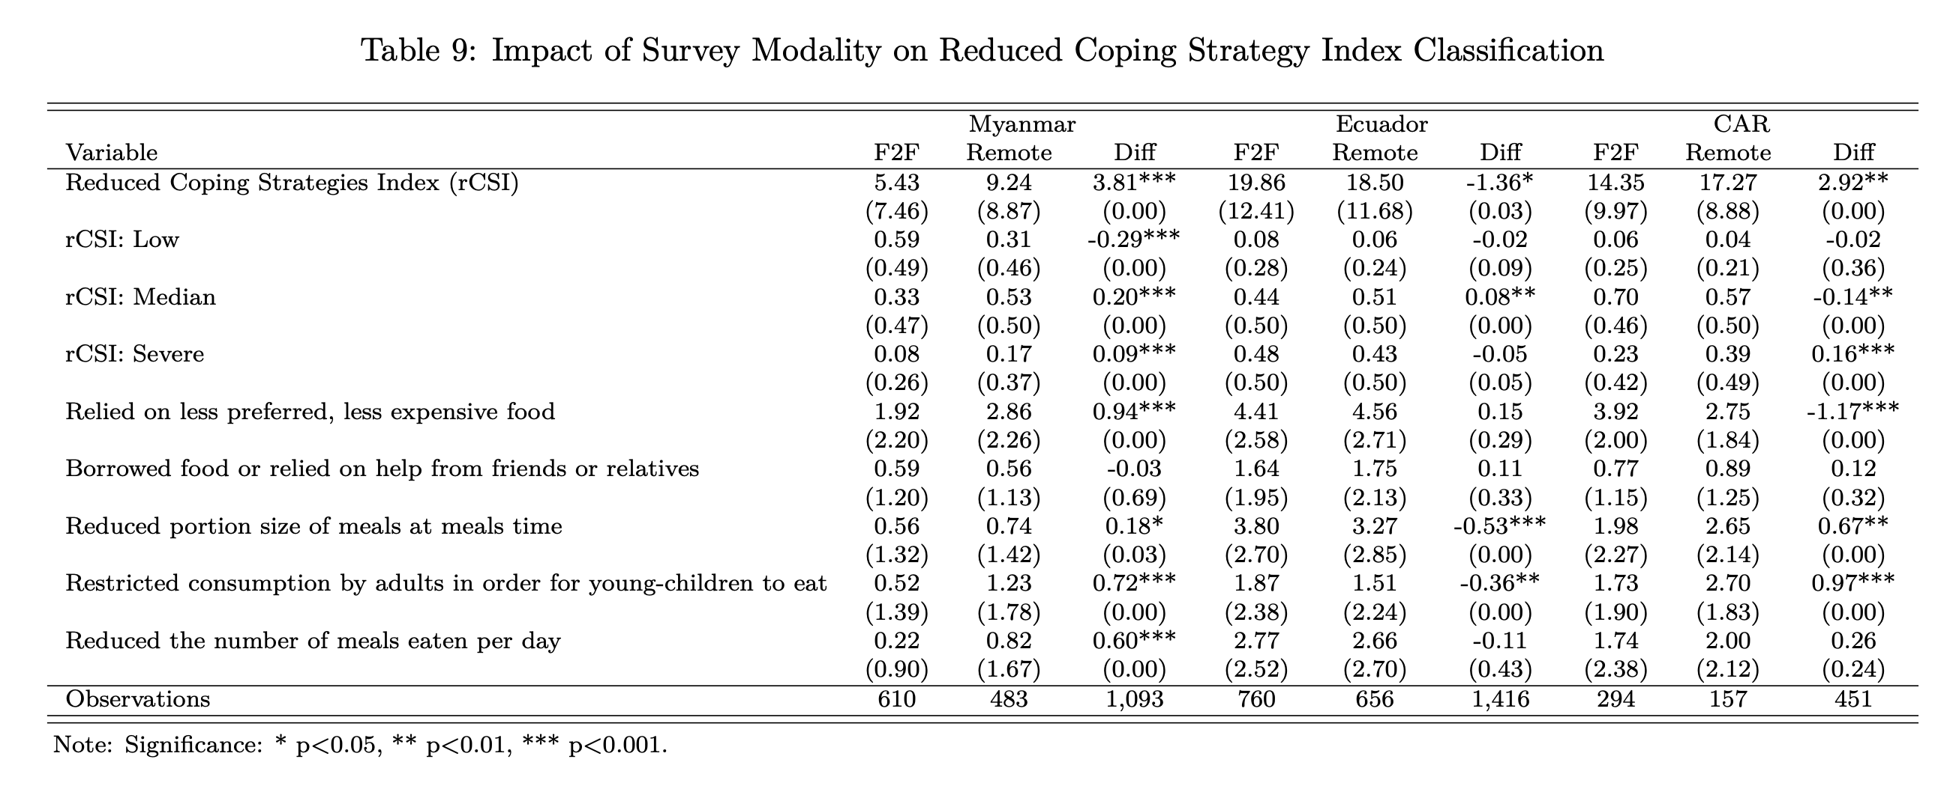

Slide 28
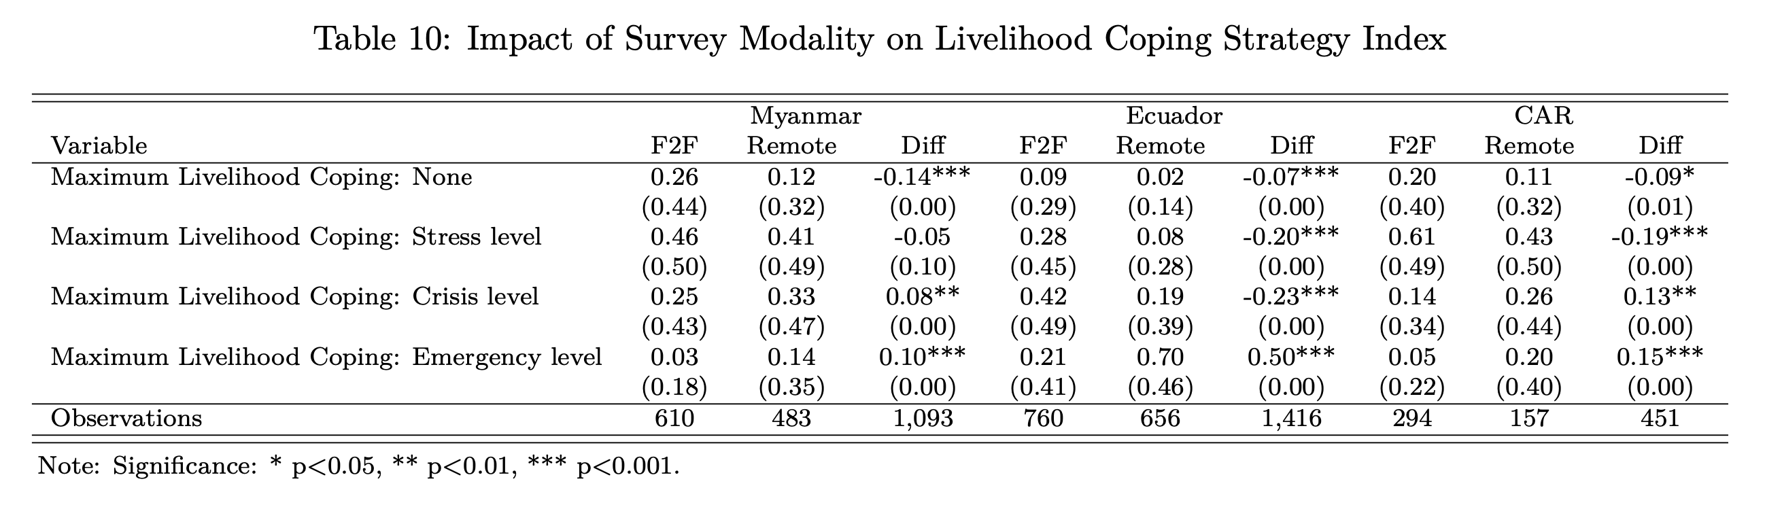

Slide 29
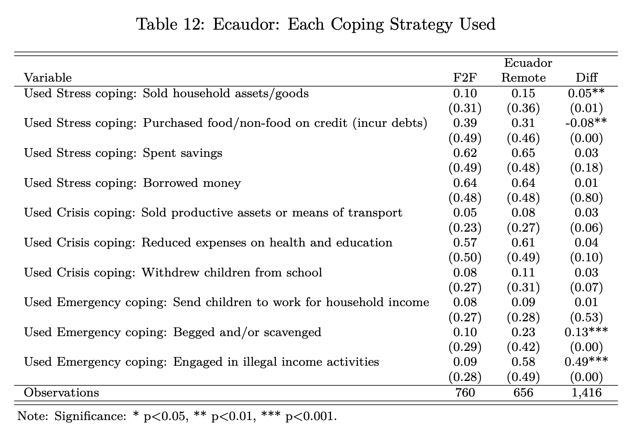

Slide 30
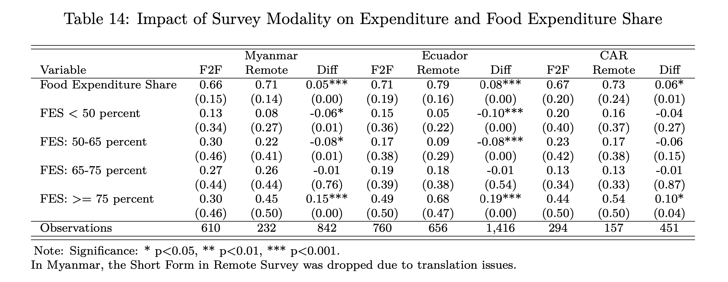

Slide 31
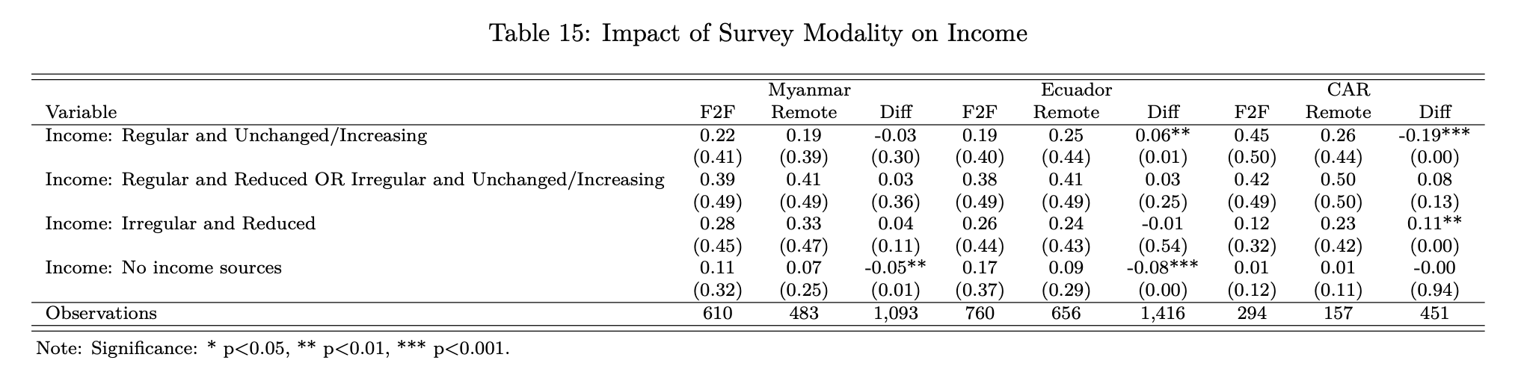
Notes:
Remote is conservative in reporting food insecurity (CARI category 4) using income

Slide 32
Summary of key results
Indicator | Summary
1. rCARI-Inc | Not significantly different from standard CARI (CARI-FES) in Myanmar & Ecuador In CAR results are significant but on the conservative in estimating FI by 21% points
2. CARI-Inc | Significantly under reports FI across the 3 pilot countries by between 6% and 22% points
3. rCARI-FES | Over-reports food insecurity compared to the standard CARI by between 16% and 17% points
4. FES, FCS, rCSI & Income source | Similar results found between remote and F2F modalities (where there is difference, the magnitude is minimal (FES = 5 to 8 points), (FCS = 1 to 8 points), (rCSI = -1 and 4 points)
5. LCS | Is significantly higher over the phone compared to F2F (between 18 and 28% points)

Slide 33
Highlights…
What happens replacing FES with Income change variable?

Slide 34
Highlights…
 | MMR | ECU | CAR |  | MMR | ECU | CAR | Diff (Inc-FES)
Income source | F2F-HH | F2F | F2F | FES % | F2F-HH | F2F | F2F | MMR | ECU | CAR
Irregular & reduce | 0.28 | 0.26 | 0.12 | FES: 65-75 | 0.27 | 0.19 | 0.13 | 0.01 | 0.07 | -0.01
No income sources | 0.11 | 0.17 | 0.01 | FES: >= 75 | 0.30 | 0.49 | 0.44 | -0.19 | -0.32 | -0.43
Irregular & No income | 0.39 | 0.43 | 0.13 | FES >= 65 | 0.57 | 0.68 | 0.57 | -0.18 | -0.25 | -0.44
Observations | 610 | 760 | 294 |  | 610 | 760 | 294 | 610 | 760 | 294
Notes:
Looking at the category 3 and 4 of CARI. We see that Income and Income sources will significantly under report food insecurity by 18% and 44% across the 3 countries.

Slide 35
Highlights…
Conventional rCARI (income) largely underreports FI
All indicators are largely comparable between F2F and Remote
Where different, it is MINIMAL
FI estimated by the FES as an absolute value is always higher compared to the Income and income sources indicator
If Income replaces FES, CARI will be conservative in reporting FI

Slide 36
Next steps…
Resume data collection – Burkina Faso, Lebanon & Guatemala
Further in-depth analysis of the data
Aggregate the full sample from CAR
Apply weights to the data particularly RM (where possible)
Long and Short modules
Explore further the use of the income and income change variable as a standard food security indicator

Slide 37
Thank you!!

